Slide 1
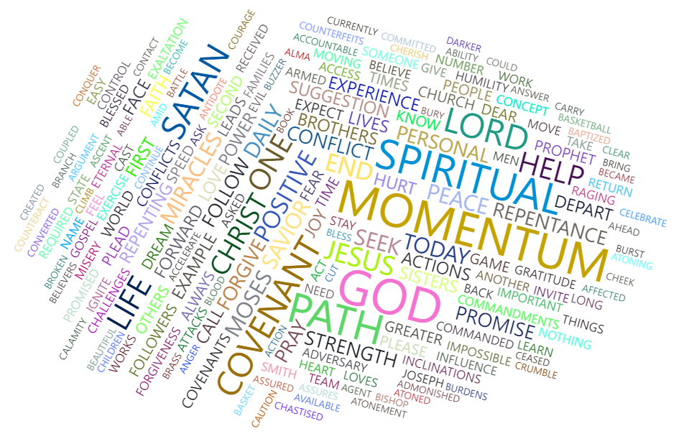
Word Cloud Dashboard - The Power of Spiritual Momentum
Andrew Jensen

Slide 2
Biggest Overall Topics
Purpose: highlight the main points of President Nelson’s talk.

Slide 3
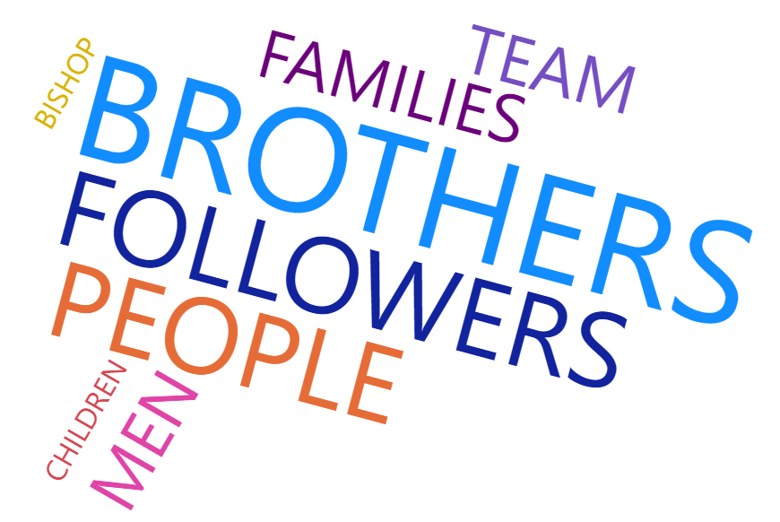


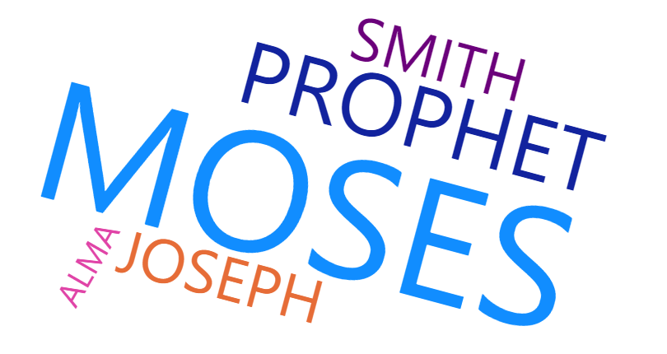
Individuals and Groups of People

Slide 4
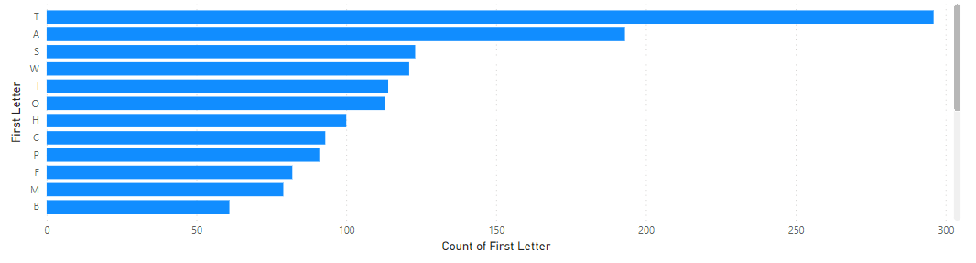
Most Frequent First Letters
Shows which letters are most likely to appear at the beginning of each word, sorting by frequency

